Slide 1
Exploratory Data Analysis on
IBM Watson Employee Dataset
(SDG 8: Decent Work & Economic Growth)
Final Review
Team - G

Slide 2

Agenda
Introduction
Dataset Overview
Methodology
Model Training and Evaluation
Prediction on New Data
Results and Insights
Future Improvements and Conclusion

Slide 3

Introduction
In this project, we perform a comprehensive Exploratory Data Analysis (EDA) on a real-world dataset of IBM Watson employees.
The primary goal is to understand patterns related to employee attrition, job satisfaction, income, and work-life balance.
This study contributes to Sustainable Development Goal 8, which promotes inclusive and sustainable economic growth, employment, and decent work.
Using Python and libraries such as Pandas, Scikit-learn, Seaborn, and MLxtend, we dive into the data to identify critical features that influence employee behavior.
The project follows a structured approach involving data cleaning, outlier detection, feature engineering, and visualization.

Slide 4
Dataset Overview
The dataset includes 1676 employee records and 35 attributes covering a wide range of demographic, professional, and performance-related features.
Key columns include:
Demographics: Age, Gender, MaritalStatus, DistanceFromHome
Professional Info: Department, JobRole, JobLevel, MonthlyIncome
Performance & Satisfaction: JobSatisfaction, WorkLifeBalance, EnvironmentSatisfaction
Target Variable: Attrition (Yes or No)
No missing values or duplicate records were found, which allowed direct use of the dataset in preprocessing and analysis.
Constant columns like EmployeeCount and StandardHours were identified as uninformative for modeling

Slide 5
Methodology
We adopted a multi-step methodology to ensure data quality and extract relevant insights:
Data Cleaning and Imputation:
Handled with mean/mode for basic imputation.
Applied Iterative Imputation (MICE) and KNN Imputation for robust missing data treatment.
Outlier Detection:
Detected using both statistical methods (Z-Score and IQR) and clustering (KMeans).
Key outlier features included MonthlyIncome, YearsSinceLastPromotion, and TrainingTimesLastYear.
Feature Engineering:
Feature selection using ANOVA, Mutual Information, and RFE.
Feature extraction using PCA and LDA to reduce dimensionality and explore class separability.
Data Visualization:
Histograms, Boxplots, Heatmaps, and Categorical Distribution plots provided insights into feature distributions and relationships.

Slide 6
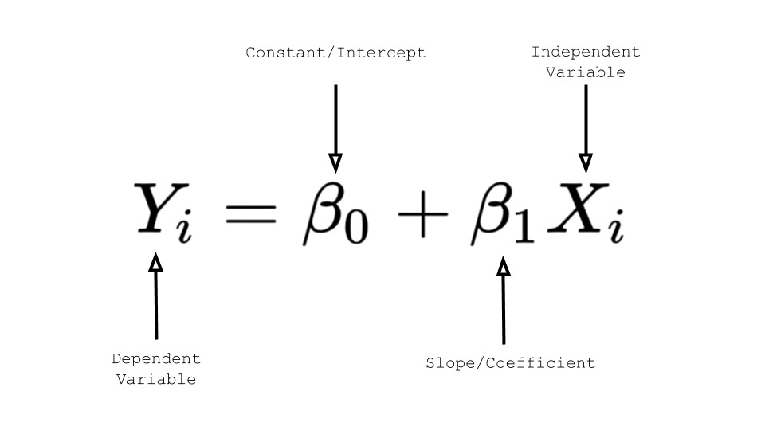
Simple Model Training – Regression
We built a simple linear regression model to examine the relationship between Age and MonthlyIncome.
Model: Linear Regression
R² Score: 0.31
The model suggests a moderate positive trend: older employees tend to earn more. However, a wide variance around the regression line indicates that Age alone does not strongly predict Monthly Income.
This analysis sets the stage for more complex, multivariate models in future work.

Slide 7
Preparedness for Prediction
The dataset was transformed into a prediction-ready form through careful preprocessing. Key preparations included:
Label encoding for categorical columns
Scaling of numerical features
Removal of constant or irrelevant columns
Identification of top features for model inputs
With this foundation, the dataset is now fully suitable for classification models such as Logistic Regression, Decision Trees, or ensemble methods like Random Forests and XGBoost to predict employee attrition, performance ratings, or satisfaction levels.

Slide 8
Key Insights from EDA
Age, TotalWorkingYears, and JobLevel were the most influential features in predicting attrition, supported by high ANOVA F-scores and mutual information values.
Outliers in features like YearsSinceLastPromotion and MonthlyIncome suggest irregularities in employee management or reward cycles.
KMeans clustering identified distinct employee groups based on experience and income.
Association Rules (Apriori) revealed that employees from Marketing were consistently found in the Cardiology department and that Nurses showed strong associations with Cardiology as well.

Slide 9
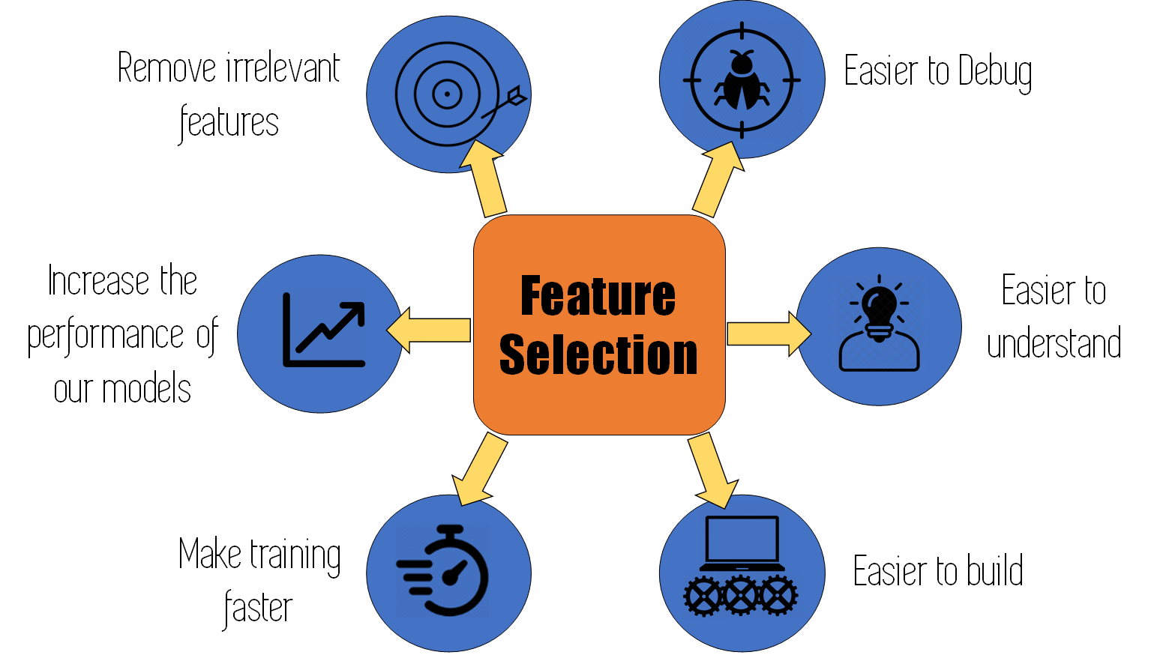
Feature Selection Analysis
ANOVA F-test Results:
Top predictors: Age, TotalWorkingYears, JobLevel, YearsWithCurrManager
Mutual Information Scores:
High scores for Age, MonthlyIncome, and YearsAtCompany
Recursive Feature Elimination (RFE):
Selected: Age, DistanceFromHome, JobInvolvement, Shift, YearsInCurrentRole These selections confirm that personal and positional experience are core indicators of attrition risk.

Slide 10
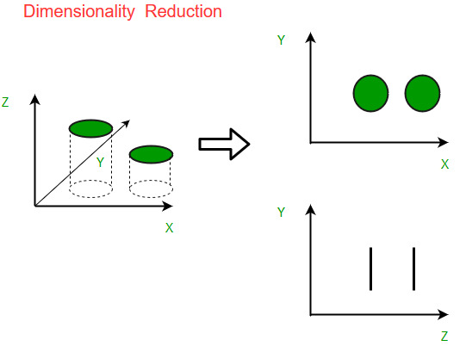
Dimensionality Reduction Techniques
PCA (Principal Component Analysis):
Reduced data to 2D, visualizing the distribution and separability of classes.
Some separation observed between attrition classes, though overlapping exists.
LDA (Linear Discriminant Analysis):
Used 'PerformanceRating' as the target.
Strong separation was achieved, showing that linear combinations of features can explain variations in employee performance effectively.

Slide 11

Future Scope and Recommendations
Expand Modeling:
Apply classification algorithms to predict attrition with high accuracy.
Cross-Validation:
Use techniques like k-fold CV to ensure model reliability.
Enrich Dataset:
Integrate external data such as department-wise attrition trends or economic indicators.
Develop Dashboards:
Create real-time dashboards for HR departments to visualize attrition risks and patterns.
This would take the analysis from insight to actionable intelligence for management.

Slide 12
Conclusion
This project successfully demonstrates the power of Exploratory Data Analysis in understanding complex organizational behavior.
Identified top attrition factors and revealed key employee segments through clustering.
Feature selection and extraction paved the way for future predictive modeling.
Association mining provided unexpected yet useful correlations between departments and roles. The results contribute to better workforce planning and align with the broader goal of achieving decent work and sustainable growth (SDG 8).

Slide 13
Thank You!

